Slide 1
The Historical Perspective of Quality Assurance
Debashis Jena, Raul Benavides, Kristen Uwamechuna-Akande, William Slaven

Slide 2
Definition of Quality Assurance
Quality Assurance - a systematic process of determining whether a product or services meets specific requirements.
Process based and focused on the system
Proactive approach towards Quality
Focused on Staff function
Works towards Preventing Defects
The broad spectrum of quality management
Notes:
To start the presentation we need to define Quality assurance. (read the meaning)
As mentioned, Quality assurance looks at the overarching system. It is the means which an analyst reviews the process of the system. It is a proactive approach towards the improvement of the quality of a product. It focuses on how the staff and systems interact with each other so that they can actively prevent defects. Quality assurance is the inside the spectrum of quality management.

Slide 3
Quality Assurance vs Quality Control
Quality Assurance(QA) Can be confused with Quality Control(QC)
QC is a subset of QA
 | Quality Assurance | Quality Control
Approach | Proactive | Reactive
Step in Cycle | Planning Phase/ Process Analysis | End of Development/ Product Analysis
Example | Process Review manual | Stress test of toy
Orientation | Process oriented | Product oriented
Notes:
Quality Assurance and Quality control are very commonly mistaken for the other. So let’s look at a comparison of both.
Quality Assurance encapsulates Quality control as even the process taken to drop of quality must be constantly reviewed. While Quality assurance is Proactive, Quality control is the reactive process towards the product. Quality control tends to occur when the final product is developed and is the means that the product is analyzed to meet certain requirements. An example of quality control would be stress testing a toy and making sure that a batch of a product meet standards. While Quality Control is product oriented Quality Assurance is Process Oriented.

Slide 4
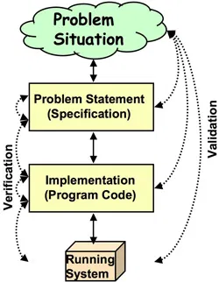
Verification vs. Validation
Verification- process of evaluation steps that lead up to development phase to determine if it meets the specified requirement of the stage. The Investigation in quality assurance.
Validation- Process of evaluation product during or at the end of development to determine if product meets requirements.The Investigation in quality control.
 | Verification | Validation
Type | Static Testing | Dynamic Testing
Timing | Planning Phase | End of Development Phase
Evaluation | Plans, documents, requirements, and specification | Products
Inputs | Checklist, issues list, Walkthroughs and inspection | Testing of product
Outputs | Documents, plans , specification and requirements | The product
Notes:
Now there are 2 steps in Quality Control: the Verification and Validation of the system. They are the steps taken to make sure a process produces the best quality and takes measures to ensure quality.
Read Definitions
Verification as seen on the picture is analyzing how each step affects the other.
Validation takes the perspective of the problem and makes sure each step is created with the product in mind.
The table is used to see differences.

Slide 5
Quality Assurance
To be able to Improve on the future of Quality Assurance, History must be analyzed
The Presentation will cover:
Origin of Quality Assurance
Incorporation of the Scientific Method
Automation in Quality Assurance
Future of SDLC and Quality Assurance
Notes:
Now finally to be able to get a total understanding of quality assurance we must go over the history of how certain methodologies arose. We have constantly been striving to improve the quality of products and that stems from our need to make bigger and better things. We will review the origins and history as well as the incorporation of the scientific method to produce better methodologies. Later the automation of quality assurance and finally review of some future aspects of quality assurance the incorporation of it to the SDLC.

Slide 6
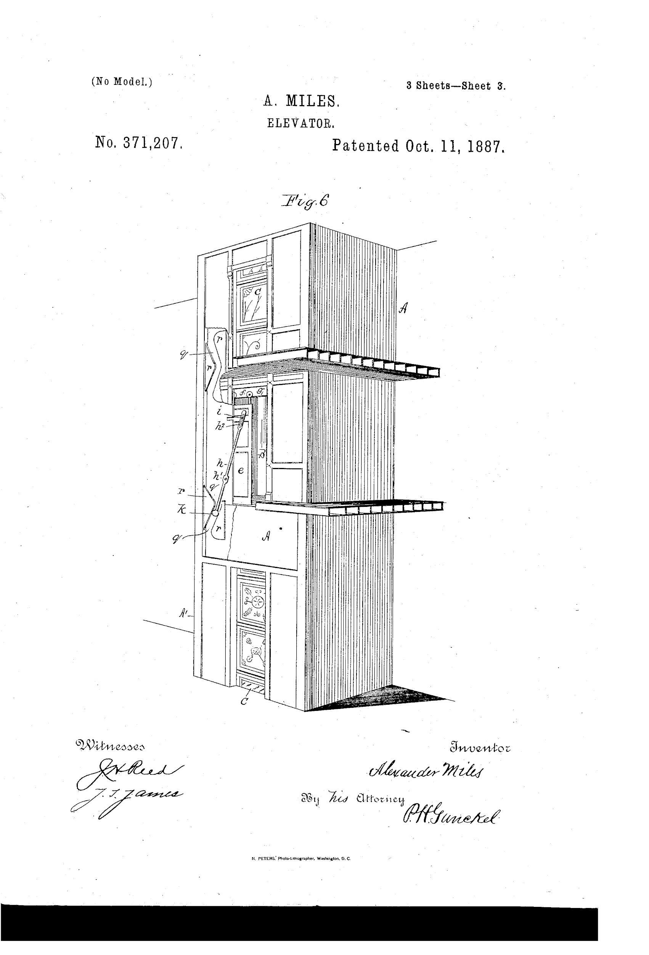
Historical Perspective
Automatic open and automatic closed elevator system
Durable and flexible belt
Design still influence modern designs
In 1887, Alexander Miles, an African American inventor improved upon the patent developed by John W. Meaker.
An automatic open and automatic closed elevator system
The purpose was to reduce having to manually open and close the doors and causing potential hazards if the shafts were left ajar.
Notes:
Alexander Miles, an African-American inventor, decided to improve on John W. Meaker’s invention of the first automatic elevator door system (“Alexander Miles”, n.d ). While riding the elevator with his daughter he observed the risks involved if the elevator shaft door is left ajar (“Alexander Miles”, n.d.).
The opening and closing of the doors including the shaft and the elevator had to be manually done by the elevator operator or the passengers (“Alexander Miles”, n.d ). People would often forget to close the shaft and would precede to use the elevator and there were many reported hazards to those aboard (White, 2018 ). Miles took action to draft a design that would allow for the doors to automatically close by attaching a durable and flexible belt to the elevator cage and when it connected with drums positioned along the shaft below and above the floors, the shaft doors were automated to close due to levers and rollers along the doors. (“Alexander Miles,” n.d ). This greatly improved the efficiency of the elevator and is still a standard feature to this day (“Alexander Miles”, n.d.).

Slide 7
Historical Perspective
Guilds
Formed in the 13th century
Organized by craftsmen and merchants
Individual skill was he driving factor for quality
Promoted education and training
Verified the quality of goods and services
Notes:
The Pre-Industrial era introduced Guilds, a union of craftsman and merchants formed during the 13th century and monopolized the economic stability of the time (Bosshardt & Lopus, 2018). There were two subsets of Guilds which include craftsmen and artisans and merchant guilds that included merchants in a town, or a city, involved in regional and long-distance trade (Bosshardt & Lopus, 2018). They were very prominent throughout Europe during the 11th and 16th centuries and provided opportunities for division of labor, productivity, perfecting skills and education, and monopoly of power (Bosshardt & Lopus, 2018).
Guilds were organized to provide apprentices an opportunity to be trained and educated by established artisans and craftsmen connected with the guild (Thoppil, 2018). This function led to specialization of jobs and tasks and quality started to be more process-oriented more than human oriented (Thoppil, 2018). Workers divided the labor based on a occupation and within that particular occupation, the workers produced a good, while lowering the costs of labor (Bosshardt & Lopus, 2018; Thoppil, 2018).
The quality of goods was overseen by monarchs and masters of guilds would inspect the goods to ensure that a standard was met by the members in the guild (Mooney, 2013). This was achieved because members of the guilds had self-interest in the economic value and did not tolerate anything less (Bosshardt & Lopus, 2018).
Though guilds faded with the onset of the Industrial Era, its functions still have a lasting effect today with labor unions as they are structured to still engage members to care about the interests of all members (Bosshardt & Lopus, 2018).

Slide 8
Historical Perspective
Scientific Management- A theory developed and implemented by Frederick Winslow Taylor during the industrial age
Focused around 4 principles:
Replace “rule of thumb”, working by habit and common sense, with the scientific method
Match workers to jobs based on their capability and motivation and then train them to do that job efficiently.
Monitor the workers performance and provide instruction and supervision to ensure they are working at maximum efficiency.
Allocate the work between managers and workers so that time can be delegated to planning and training.
Notes:
Quality was person dependent during the 19th century and during the time of industrialization quality became more process-oriented (Thoppil, 2018). As workers became more discontent and less motivated due to the monotony of the task set before them, Frederick Winslow Taylor’s theory of Scientific Management helped to reshape the minds of the workers and industrial efficiency (Thoppil, 2018).
In the 20th century, the progressive time of the Industrial Age, Frederick Winslow Taylor, a U.S. steel manufacturer with a background in mechanical engineering, is known for his philosophy focused on the belief that working harder does not equivalent to working efficiently (Giannantonio & Hurly-Hanson, 2011). His work contributed to management practices and it included task specialization, assembly line practices, job analysis, work design, incentive schemes, person-job fit, and production quotas and control (Giannantonio & Hurley- Hanson, 2012).
He proposed that optimizing how the work was being done and simplifying the procedures increased productivity (“Frederick Taylor and Scientific Management”, n.d.).
To test his theory he designed workplace experiments for the purpose of qualifying the physical performance of the average worker and the physical performance of the equipment used in a particular task such as shoveling and brick laying (“Frederick Taylor and Scientific Management”, n.d.). In this product driven environment, his application of the scientific method he discovered that calculating the time allocated towards a task, he could derive the most efficient way to complete the task (“Frederick Taylor and Scientific Management”, n.d.). These studies were coined "time and motion" and ultimately led to the conclusion that selecting the right people for a task was just as important to workplace efficiency. He and his associates were the first to study the work process scientifically (“Frederick Taylor and Scientific Management”, n.d.).
Taylor published his work in 1911, The Principles of Scientific Management, laying out the process of scientifically increasing worker and organization efficiency (Giannantonio & Hurley-Hanson, 2011). He summated his philosophy into four main principles, working out of simple habit or common sense is replaced by using the scientific method to determine more efficient ways to perform specific tasks, capability, motivation, and training should determine which worker is assigned to a job, work performance should be monitor and where needed, instruction and supervision are tools to ensure efficiency, and work should be distributed to managers and workers(“Frederick Taylor and Scientific Management”, n.d.).
Frederick Taylor and scientific management. Retrieved from https://www.mindtools.com/pages/article/newTMM_Taylor.htm

Slide 9
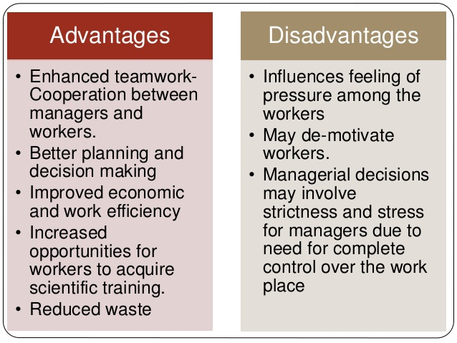
Taylorism and Today
Notes:
Taylorism and Today
Scientific Management focuses more on narrowing down "one right way" to perform a task. Rapidly changing environments, today, require a more malleable approach
and depends wholly on the front line workers perspective (Frederick Taylor and Scientific Management, n.d.). Modern methods seek to involve the workers ideas, experience and knowledge so that procedures and processes can be molded and maximize productivity (Frederick Taylor and Scientific Management, n.d.).
Scientific Management is more process driven in that it seeks to study each step and focuses on how each worker can do their specific tasks best. Today, there is more of a push for teamwork and less of a dependency on managerial decisions (Frederick Taylor and Scientific Management, n.d.). There is also more of an understanding that constant managerial input and decision making can de-motivate workers and downplays their experience and perspectives (Frederick Taylor and Scientific Management, n.d.).
http://aypaperttwr.ff-umhausen.org/advantages-and-disadvantages-of-taylorism-scientific-management-pavalahyz8837.html

Slide 10
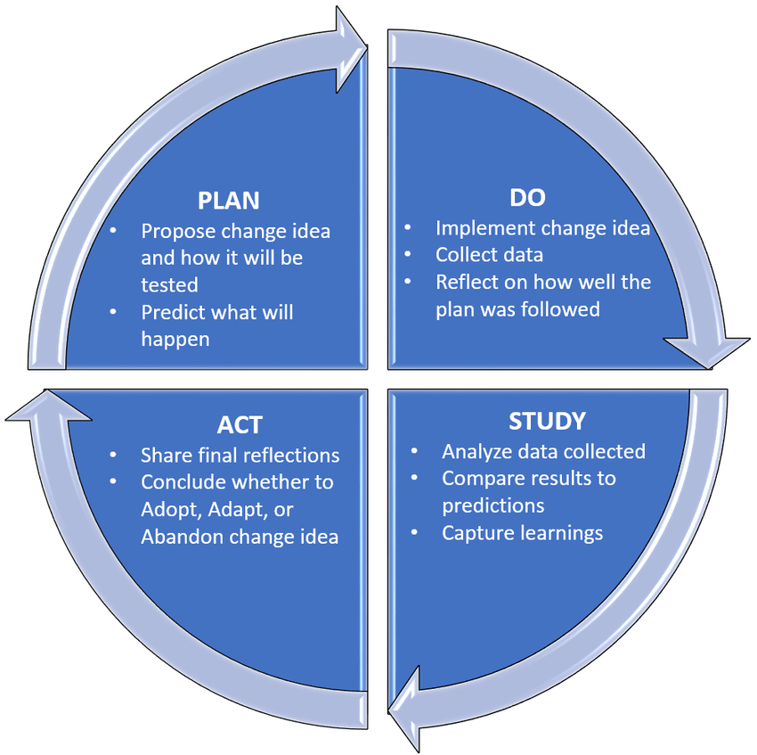
Historical Perspective
Walter Shewhart- In the 1930’s, improved on Scientific Management
Introduced the use of Plan-Do-Study-Act method (PDSA)
Both quality control and quality assurance were practised to some extent in the “study” phase of PDSA.
Notes:
The PDSA method is used to test a change that is implemented. The four steps provides the direction for the thinking process by breaking down each task into steps and then analyzing the results, improve on them, and test it again (“Plan-Do-Study-Act (PDSA) Directions and Examples, n.d.) Walter Shewhart saw that there was a need to improve quality systems and his PDSA method produced cycles of increasing quality in the manufacturing processes using statistical techniques (Mooney, 2013; “W. Edwards Deming”, n.d.).
Plan- Here is where an explanation of what the plan for the project is, what outcome is expected, and what steps will be taking to accomplish the plan
Do- Execution of the plan and writing down what you observe
Study- Study the results and write down how did it work
Act- What did you come away with, did it work, if not, what can be change? If it did work, will this be implemented?
Mooney, G. (2013, March 26). The history of quality assurance. Retrieved from https://smartbear.com/blog/test-and-monitor/the-history-of-quality-assurance/
Plan-Do-Study-Act (PDSA) directions and examples. (n.d.) Retrieve from https://www.ahrq.gov/health-literacy/quality-resources/tools/literacy-toolkit/healthlittoolkit2-tool2b.html
https://www.researchgate.net/figure/A-visual-diagram-of-a-Plan-Do-Study-Act-PDSA-Cycle_fig1_319377456
(n.d). W Edwards Deming. Retrieved from https://www.bl.uk/people/w-edwards-deming

Slide 11
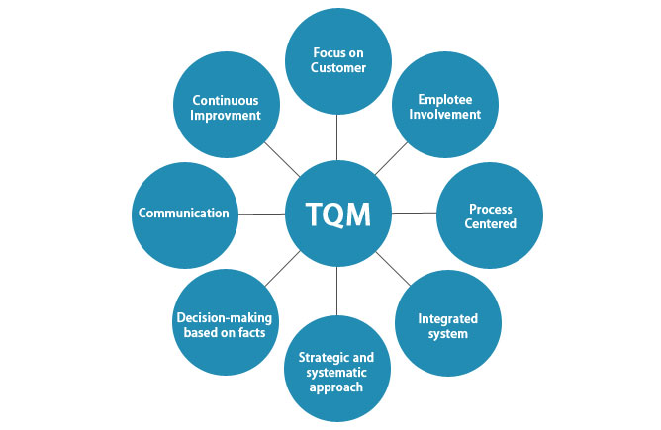
Historical Perspective
Total Quality Management (TQM)
Originally started in 1954
Organized structural tool that focuses on continuous quality improvement of product
Introduced by Deming as a process to improve the workforce and its processes
W. Edwards Deming - influenced Japan’s enterprises in 1970 by using William Shewhart’s PDSA methods
Influenced Agile development
Notes:
William Edwards Deming was a statistician and business consultant and he is known as the founder of the Quality Management movement (W Edwards Deming, n.d.). He took interest into why things do not turn out as predicted and recognized that there are variations to why a system is not working properly and often workers know what those variations are over management because as workers they were more intune with their tasks (W Edwards Deming, n.d.). He introduced 14 points that created a framework to increase knowledge in the workforce for management and created a philosophy more than an action plan. He introduce TQM which focuses on continuous improvement and in order for such an achievement to accomplished management would have to commit to being more involved with understanding processes and then relaying the importance of quality to their employees (W Edwards Deming, n.d.). Deming’s methods sought to save money and ease the workload when all aspects of the development process are documented and analyzed; therefore placing emphasis on management and staff to share the responsibility of commitment to quality(W Edwards Deming, n.d.)
In 1970, Deming became known for his accomplishments in Japan after the Second World War as an advisor to the Japan Census (W Edwards Deming, n.d.)The Japanese wanted to improve their quality of goods, raw materials, and production (W Edwards Deming, n.d.). He was very familiar with William Shewhart’s PDSA method and introduce it along with his own take and focused it towards quality management (W Edwards Deming, n.d.).
These methods led to Agile development processes seen today (W Edwards Deming, n.d.). Agile is centered around iteration (repetition of a process) to create a series of outcome or results that build upon change and helps teams narrow down a closer solution to a particular problem and collaboration over documentation (Sacolick, 2018).
https://www.educba.com/what-is-total-quality-management/
(n.d). W Edwards Deming. Retrieved from https://www.bl.uk/people/w-edwards-deming

Slide 12
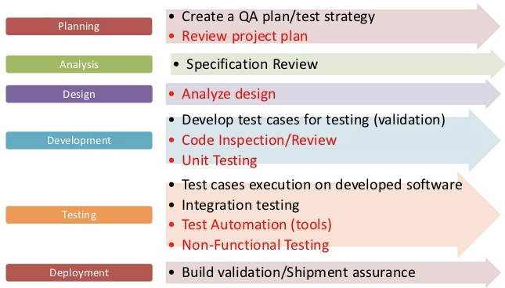
QA in SDLC
Quality Assurance an integral part of any SDLC process
Each phase of an SDLC must have a QA starting from Planning, Analysis, Design, Implementation
QA is not only testing the application, rather
Reviewing project plan, specification requirement review, code inspection / walkthrough, Test design, Requirement traceability matrix, peer reviews and documentation of incidents
Testing application includes both functional and non-functional part
Notes:
QA in SDLC
QA != Testing. Testing is a subset of QA.
QA includes:
Review of project plan
Requirement gap analysis
Code inspection, peer review and walk-thru
Test design and use case creation
Requirement traceability matrix for 100% coverage
Testing
Recording defects / bugs

Slide 13
Evolution of QA in SDLC
Debugging oriented period - The concept of program check out, debugging and testing were not clearly differentiated
Demonstration oriented period - The goal of testing was to make sure that the software satisfies its requirements
Destruction oriented period - The primary goal of testing was implementation fault detection
Evaluation oriented period - The goal of testing was to provide product evaluation during the software life-cycle
Prevention oriented period - The goal of testing was to demonstrate that software satisfies its specification, to detect faults and to prevent faults
Until 1956
1957 - 1978
1979 - 1982
1983 - 1987
Since 1988
Notes:
Evolution of QA
The QA has grown from being reactive to proactive in it’s journey so far. Until mid 1950s, the defects in any systems were identified by debugging, which is essentially the aftermath of the incident.
Gradually, this method changed to be proactive or preventive. From the 1950s till mid 1980s, the QA process witnessed many changes, which brought in the understanding of the difference between verification and validation.
Currently many processes are being followed to prevent any defects after the system has been deployed to production. As discussed in the previous slide, a few of the preventive actions are:
Code analysis and walkthroughs
Peer review
Unit testing
Integration testing
System testing
Alpha / Beta testings
Reference:
Irandoust, K (2016, Nov 18) Concept evolution of software testing (part 2) Retrieved from https://itnext.io/concept-evolution-of-software-testing-part-2-229cf9309c49

Slide 14
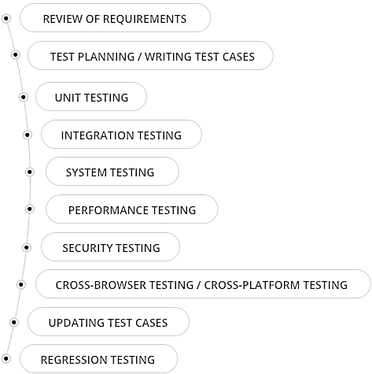
QA Phases
Requirements review for gap analysis (Verification process)
Create test plans to validate requirements
Developers write unit tests to validate each unit or module
Integration tests are done to test the integration points
After integration, the end-to-end or big-bang or system testing is done
Performance testing - non-functional type to validate response time
Security testing - ensures the app has a sufficient protection level
Cross-browser testing ensures the app is not platform specific
Each change in the requirement needs a test case update
Regression testing ensures new fixes did not break existing features
Notes:
Phases in QA process -
The two of the major phases in software development are 1) development / implemantation, 2) testing team. As development has multiple phases, similarly testing team has different phases too.
Some of the above mentioned phases belong to both the teams, they go through those phases separately or together.
However, phases that belong specifically to the testing team are:
Test planning / writing test cases
Integration tests
System tests
Performance tests
Cross browser testing
Updating test cases
Regression tests - where they run tests for existing features. Best candidate for automation.
Reference:
(n.d.) QA Process: How the QA Team Tests Your Project, retrieved from https://kruschecompany.com/quality-assurance-in-projects/

Slide 15
Automation in QA
Automation in Functional Testing - Used for regression tests and for repetitive tasks - As the system goes through multiple releases, regression test suite grows by volume
Reduces time & effort - Initial effort to write automation tests is high, but in the later phase while executing the same, the effort reduces by many folds
Increases productivity - Resources can utilize the time to do other productive work while the automation tests are running
Increases reliability - Since these are run by tools, automated tests are less error prone than manual tests
Automation in Nonfunctional Testing - Used for load/stress testing
Load testing is done to define the maximum amount of work that a system can handle without significant performance degradation.
Notes:
Automation in QA -
As mentioned in the previous slides, the regression testing phase is the best candidate for automation tests. However, it is not limited to regression tests only. The new features can be tested using automation tests as well.
Also, in many organization, the automation tests run on the production site periodically to check if the basic functionalities are working fine. In case any failures, the development team or the production support team is alerted. That makes the entire implementation team more proactive to take an action.
Currently, in the Continuous integration and Continuous delivery (CICD) processes, automation tests are one of the most important factors in the automated nightly release and deployment.. In this process, if automation tests fail, then the automated deployment also fails and is rolled back.
Reference:
Setter, M. (2017, September 27) 5 Reasons Automated Testing Is Worth the Investment, Retrieved from https://blog.codeship.com/5-reasons-for-automated-testing/

Slide 16

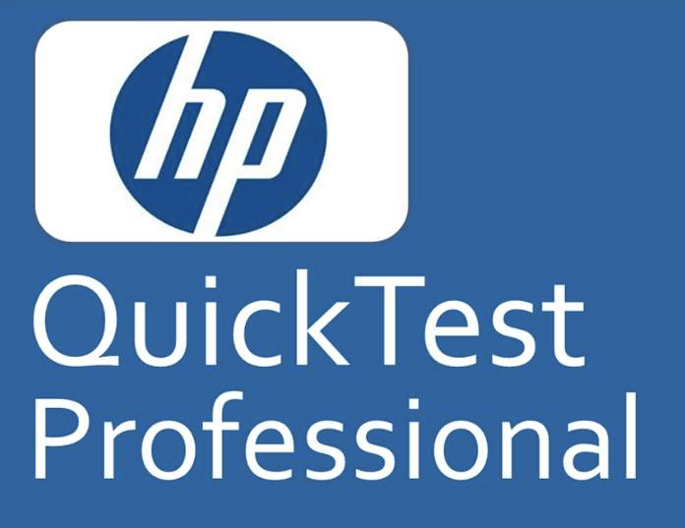



Automation Tools
Tools | Years Available | Application Under Test | Pricing | Platforms | Languages Supported | Programming Skills Reqd
WinRunner | 1993 - 2004 | Web, Windows | $$$ | Windows | VB Script | Advanced Skills Reqd
HP QTP | 2004 - now | Web, Windows | $$$ | Windows | VB Script | Required for Advanced Scripts
Selenium | 2004 - now | Web Only | Free | Windows, Linux, OS X | Java, C#, Perl, Ruby, JavaScript, Python, PHP | Advanced Skills Reqd
Watir | 2008 - now | Web Only | Free | Windows, Linux, OS X | Ruby | Required for Advanced Scripts
Kotalon | 2015 - now | Web and Mobile | Free | Windows, Linux, OS X | Java/Groovy | Required for Advanced Scripts
Notes:
Evolution of Automation Tools:
Just like any other technologies automation tools have seen many changes in their journey so far.
WinRunner was one of the first automation tools that became popular, since it had the ability to simulate user actions on a web page or in a window application. That made some of the automation tasks very easy to perform.
HP QTP was a higher version of WinRunner tool. Both of them had many features like identifying the web elements and the record-playback feature. However, they had many limitations; like they only run in specific browsers. Some technical expertise needed to write and perform tests.
Then came Selenium, which was open source, supports all browsers and many programming languages. It became the backend of many other customized automation tools. Only drawback of this tool is, programming skills is necessary for running automation tests.
Currently there are many automation tools which are cloud based and have a cost attached to the usage of those tools. They are becoming more popular because of their eas of use.
Reference:
Anderson, B. (2017, December 10) Best Automation Testing Tools for 2018, Retrieved from https://dzone.com/articles/best-automation-testing-tools-for-2018

Slide 17
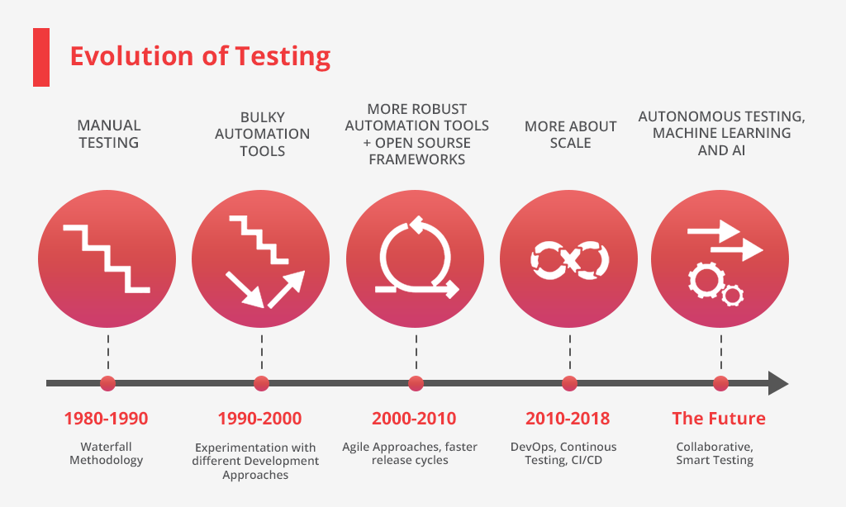
Role of QA - Transition from Waterfall to Agile
Waterfall model requires a defined QA - Testing phase, which validates the application built against the entire requirement specification
Modern Agile methodology encourages incremental testing for rolling product releases
Current process requires thorough regression testing, which can be automated
Automation tests are integral part of the CI/CD process; deployments are reverted if automation tests fail
Many automation testing frameworks and tools are emerging, which are based on selenium and other open source tools like protractor
Notes:
Change in Role of QA -
As the agile methodology became popular in software development, the QA processes also got evolved to fit into it too. The QA became less formal than earlier. In a waterfall model software development, the QA requires formal documentation for each of the activities. However, with agile methodology the need of documentation has reduced significantly, since testing story specific and the system is subject to change more often.
Reference:
No Author, (2019, May 22) It’s Better To Be Safe Than Sorry, Or Why Quality Assurance Testing Matters To Your Business, Retrieved from https://innovecs.com/blog/quality-assurance-testing/

Slide 18
Pivotal Changes in Quality Assurance Practices
Strategies have changed to implement a more agile approach because of the rapid growth and size of the information technology field.
Security processes that incorporate quality assurance have changed to incorporate encryption technology.
Strategies have changed to implement a more agile approach because of the rapid growth and size of the information technology field.
Security processes that incorporate quality assurance have changed to incorporate encryption technology.

Slide 19
Technology Trends that impact Quality Assurance
Teams are becoming more agile and so must be their quality assurance processes.
Acceptance Test Driven Development (ATDD) where customer interfaces with team designers is becoming a popular quality assurance practice.
Use of virtualization processes to see the whole concept of quality assurance.
Processes that use a continuous checking method for security have become essential.
Quality assurance processes are built into future efforts with a continuous evolution process that incorporates QA from the start through the end of all processes.

Slide 20
Future of security and quality software testing
Manual testing to automated testing, human integration will be an essential component to automated quality assurance.
Machine Learning to augment testing processes but must include multiple machines to quality assure the process.
Testers will have to accept new agile testing processes and learn new skills, this includes community inputs to integrate best practices of quality assurance.
Testers are indispensable to the future of quality assurance testing and cannot by any means be replaced by software or processes.

Slide 21
Conclusion
Application and maintenance of quality assurance will improve the quality of IT products and processes.
Improved quality assurance will ensure best practices are followed and adhered to.
Quality assurance policies will assure that all parameter of products are met to standard.
Cost Savings are certainly assured if quality assurance is incorporated at all stages of the process.
Future quality assurance needs to insure data integrity and system security.

Slide 22
References
Alexander Miles. Retrieved from http://www.myblackhistory.net/Alexander_Miles.htm
Anderson, B. (2017, December 10) Best Automation Testing Tools for 2018, Retrieved from https://dzone.com/articles/best-automation-testing-tools-for-2018
Bosshardt, W & Lopus, J.S. (2018, September 26). The role of guilds in the middle ages. Retrieved from https://brewminate.com/the-role-of-guilds-in-the-middle-ages/
Frederick Taylor and scientific management. Retrieved from https://www.mindtools.com/pages/article/newTMM_Taylor.htm
Giannantonio, C. M. & Hurley- Hanson, A.E. (2011). Frederick Winslow Taylor: Reflections on the relevance of the principles of scientific management 100 years later. Journal of Business & Management. 17(1), 7-10.
Irandoust, K (2016, Nov 18) Concept evolution of software testing (part 2) Retrieved from https://itnext.io/concept-evolution-of-software-testing-part-2-229cf9309c49
Mooney, G. (2013, March 26). The history of quality assurance. Retrieved from https://smartbear.com/blog/test-and-monitor/the-history-of-quality-assurance/
Plan-Do-Study-Act (PDSA) directions and examples. (n.d.) Retrieve from https://www.ahrq.gov/health-literacy/quality-resources/tools/literacy-toolkit/healthlittoolkit2-tool2b.html

Slide 23
References (contd.)
Sacolick, B. (2018, March 15). What is agile methodology? Modern software development explained. Retrieved from https://www.infoworld.com/article/3237508/what-is-agile-methodology-modern-software-development-explained.html
Setter, M. (2017, September 27) 5 Reasons Automated Testing Is Worth the Investment, Retrieved from https://blog.codeship.com/5-reasons-for-automated-testing/
Thoppil, R. (2018, July 12). Quality assurance in software testing- past, present & future. Retrieved from https://www.fingent.com/blog/quality-assurance-in-software-testing-past-present-future
White, D. (2018, January 4). Alexander Miles (1838-1918). Retrieved from https://www.blackpast.org/african-american-history/miles-alexander-1838-1918/
(n.d). W Edwards Deming. Retrieved from https://www.bl.uk/people/w-edwards-deming
(n.d.) QA Process: How the QA Team Tests Your Project, retrieved from https://kruschecompany.com/quality-assurance-in-projects/
No Author, (2019, May 22) It’s Better To Be Safe Than Sorry, Or Why Quality Assurance Testing Matters To Your Business, Retrieved from https://innovecs.com/blog/quality-assurance-testing/

